Slide 1
Primary and secondery effects of Thalidomide. Results from the Thalidomide study of North Rhine-Westfalia (Germany)
Dutch Thalidomide Symposium,
13.10.17, Nijmegen
Prof. Dr. med. Klaus M. Peters
Orthopädie und Osteologie,
Dr. Becker Rhein-Sieg-Klinik, Nümbrecht

Slide 2
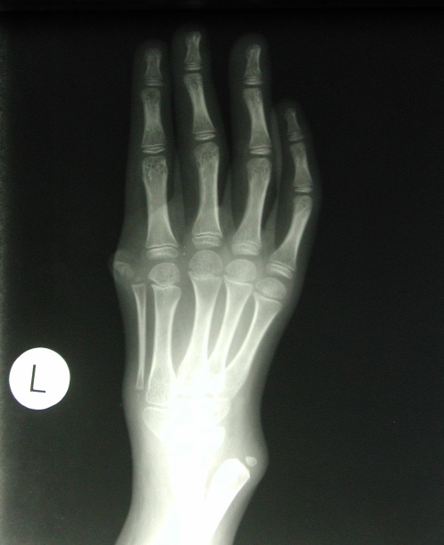
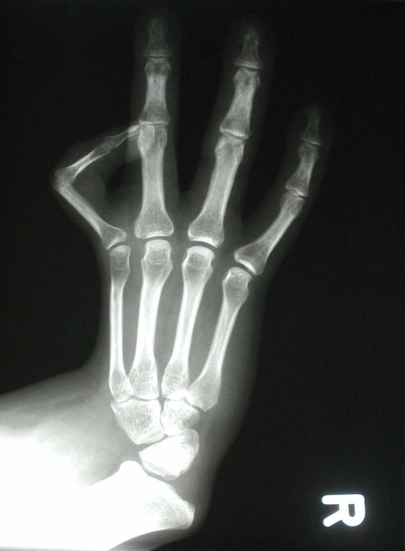
Setting
The study targeted all Thalidomide-affected people in North Rhine-Westphalia:
n=837
202 people with Thalidomide embryopathy (24%), born or living in North Rhine-Westphalia, were recruited (female:male= 115:87).

Slide 3
Methods
Thalidomide-specific questionnaire with 34 items
Pain DETECT-questionnaire
MPSS (Mainz Model of Pain Chronification)
SF 36 questionnaire
SCID-interview
systematic physical examination
X-ray, ultrasound (in selected cases)
⇨ Individual treatment recommendations for physical and mental disorders for every participant

Slide 4
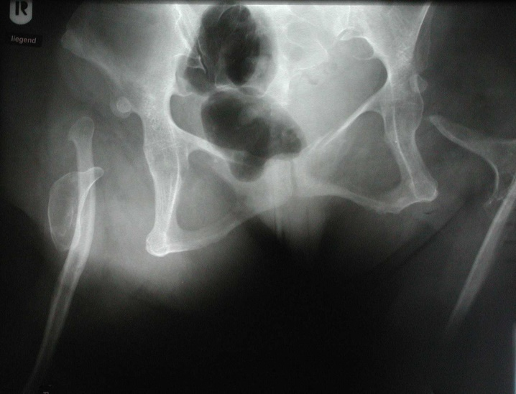
Pattern of skeletal damages (n=202)
Twofold damage
(dysmelia of upper extremities) 89,6%
Fourfold damage
(dysmelia of upper & lower extremities) 9,9%
Concomitant damages:
Hip dysplasia 57,9%
Hip luxation 7,4%

Slide 5
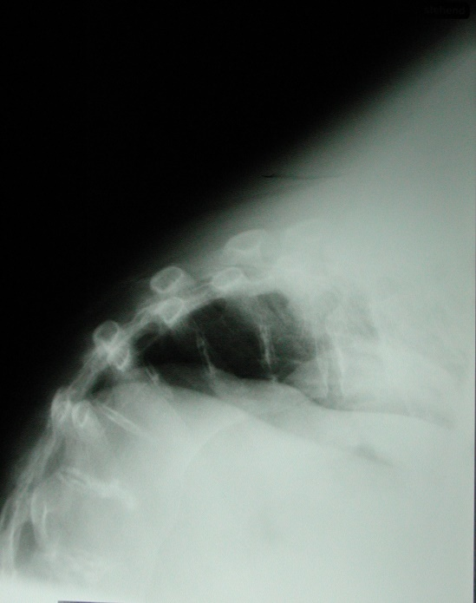
Pattern of skeletal damages (n=202)
Spine:
Scoliosis and development disorders 68,8%
Spondylolysis/Spondylolisthesis 8,4%
Dysplasia of sacral bone 5,0%
Dysplasia of jawbone 21,8%
Microsomia (dwarfism) 9,9%

Slide 6
Damages of sensory organs (n=202)
eyes 28,2%
ears deafness 16,3% hearing impairment 17,8%
flat nose 25,2%
cleft palate 0,5%

Slide 7
Internal organs (n=202)
heart defect 10,4%
intestinal malformation 7,4%
aplasia of gall bladder 6,4%
renal malformation 19,3%
inguinal hernia 11,9%
malformation of genital organs
female (n=115) 7,0%
male (n=87) 32,5%

Slide 8
Consequential damages (secondary effects):
increased tooth wear 33,7%
Pain headaches 39,1% neck pain 80,7% back pain (thoracic spine) 31,7% back pain (lumbar spine) 78,2% Upper extremities shoulder 64,4% elbow 15,8% wrist 27,2% hand 34,7% Lower extremities hip 47,0% knee 53,5% ankle joint 10,4% foot 10,9%

Slide 9
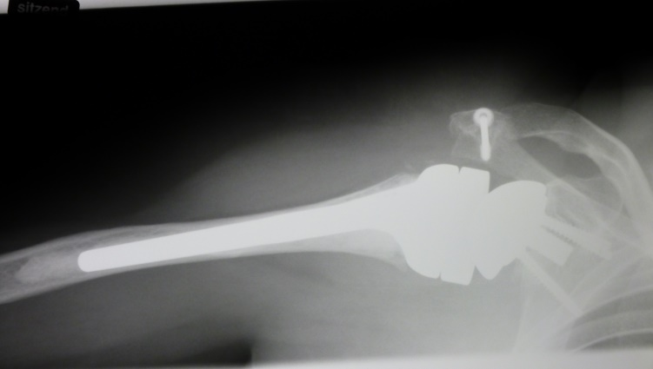
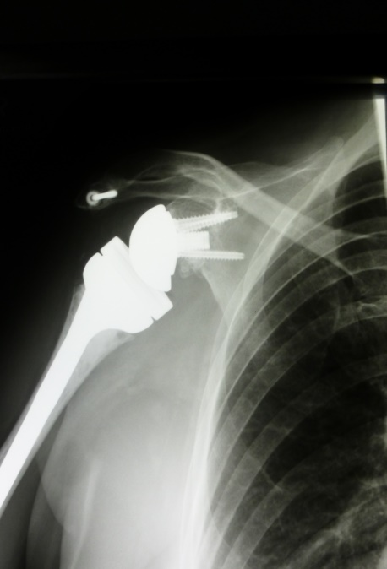
Consequential damages (secondary effects):
limitation of movement Spine cervical spine 36,6% thoracic and lumbar spine 22,3% Upper extremity shoulder 62,4% elbow 50% hand 70,8% Lower extremity hip 26,2% knee 8,9% ankle joint 7,9% foot 4,0%

Slide 10
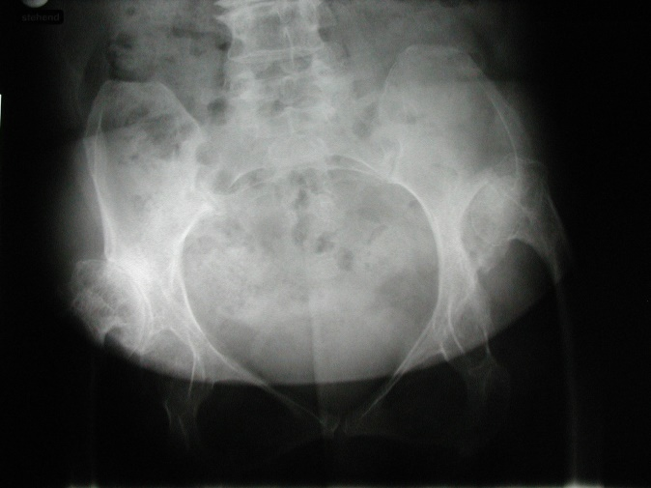
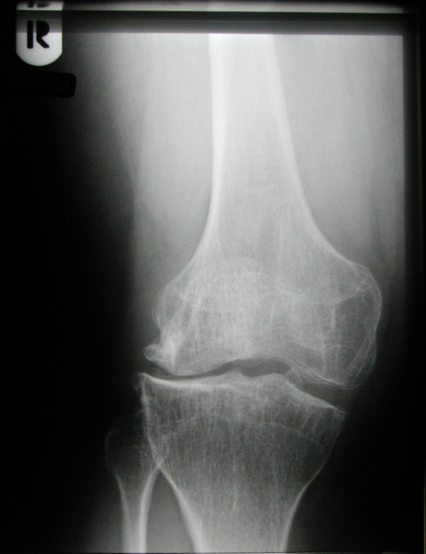
Consequential damages (secondary effects):
painful hypertonic muscle sections paracervical muscles 65,8% trapezius muscle 76,7% parathoracic muscles 39,6% paralumbar muscles 35,6%
degenerative changes cervical spine 23,3% lumbar spine 21,3% hip 16,8% knee 14,4% shoulder 7,4%

Slide 11
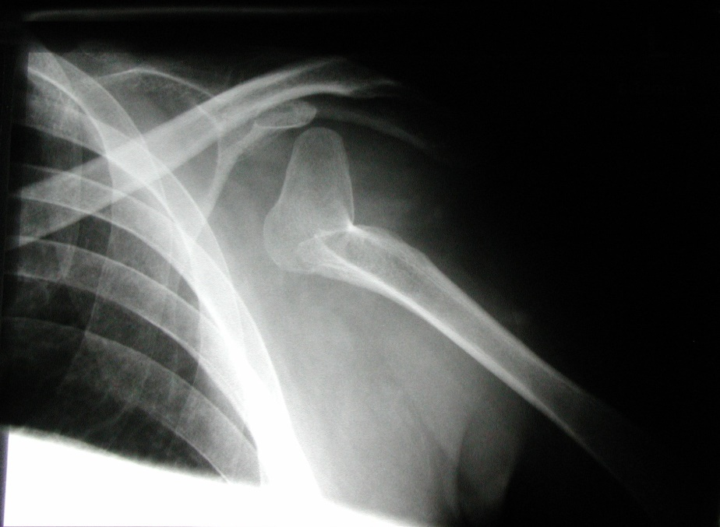
Chronic pain
MPSS Stage II + III (Gerbershagen) 62,45%
PainDETECT-Questionnaire nociceptive pain 50% neuropathic pain 50%

Slide 12
Prevalences of mental disorders
Disorder or disorder group (ICD-10 code) | 4-Week prevalence (total, n=193) | 4-Week prevalence (women, n=109) | 4-Week prevalence (men, n=84)
Neurocognitive disorder (F0x)² | 1 (0.5%) | 1 (0.9%) | -
Substance-related disorder (F1x)³ | 16 (8.3%) | 3 (2.8%) | 13 (15.5%)
- Alcohol-related disorder (F10) | 12 (6.2%) | 2 (1.8%) | 10 (11.9%)
- Medicine- and drug-related disorder | 6 (3.1%) | 1 (0.9%) | 5 (6.0%)
Psychotic disorder (F2x)² | 1 (0.5%) | 1 (0.9%) | -
Affective disorders (F3x) | 44 (22.8%) | 25 (22.9%) | 19 (22.6%)
- Unipolar depression | 32 (16.5%) | 18 (16.5%) | 14 (16.7%)
- Dysthymic disorder | 3 (1.6%) | 1 (0.9%) | 2 (2.4%)
- Minor depression | 10 (5.2%) | 6 (5.5%) | 4 (4.8%)

Slide 13
Prevalences of mental disorders
Disorder or disorder group (ICD-10 code) | 4-Week prevalence (total, n=193) | 4-Week prevalence (women, n=109) | 4-Week prevalence (men, n=84)
Neurotic, stress, and somatoform disorders (F4x) | 52 (26.9%) | 33 (30.3%) | 19 (22.6%)
- Phobic disorder (F40) | 24 (12.4%) | 14 (12.8%) | 10 (11.9%)
- Anxiety disorder (F41) | 5 (2.6%) | 4 (3.7%) | 1 (1.2%)
- Panic disorder | 4 (2.1%) | 3 (2.8%) | 1 (1.2%)
- Generalised anxiety disorder | 1 (0.5%) | 1 (0.9%) | -
- Obsessive-compulsive disorder (F42) | 2 (1.0%) | 1 (0.9%) | 1 (1.2%)
- Post-traumatic stress disorder (F43) | 6 (3.1%) | 5 (4.6%) | 1 (1.2%)
- Dissociative disorder (F44) | - | - | -
- Somatoform disorder (F45) | 27 (14.0%) | 18 (16.5%) | 9 (10.7%)
- Pain disorder | 24 (12.4%) | 17 (15.6%) | 7 (8.3%)
- Other somatoform disorders | 4 (2.1%) | 2 (1.8%) | 2 (2.4%)

Slide 14
Prevalences of mental disorders
Disorder or disorder group (ICD-10 code) | 4-Week prevalence (total, n=193) | 4-Week prevalence (women, n=109) | 4-Week prevalence (men, n=84)
Eating disorder (F50) | 5 (2.6%) | 5 (4.6%) | -
- Anorexia nervosa | 3 (1.6%) | 3 (2.8%) | -
- Other eating disorder | 2 (1.0%) | 2 (1.8%) | -
Personality disorder (F6x)⁴ | 15 (7.8%) | 6 (5.5%) | 9 (10.7%)
Mental retardation (F7x)² | 4 (2.1%) | 1 (0.9%) | 3 (3.6%)
Presence of at least one mental disorder | 91 (47.2%) | 51 (46.8%) | 40 (47.6%)
- One diagnosis² | 50 (25.9%) | 29 (26.6%) | 21 (25.0%)
- Two diagnoses | 25 (13.0%) | 14 (12.8%) | 11 (13.1%)
- Three or more diagnoses | 16 (8.3%) | 8 (7.3%) | 8 (9.5%)

Slide 15
Summary of physical disorders
More than 50 years after the withdrawal of Contergan painful consequential damages dominate the condition of Thalidomide survivors:
Thalidomide survivors:
62,4% pain chronicity of MPSS stages II + III
50% possible or probable neuropathic pain
Pain localisations:
neck > back
shoulder > knee > hip

Slide 16
Summary of mental disorders
47,2% of Thalidomide survivors with one mental disorder (four-week interval) versus 27,7% in German general population
Depressive disorders (22,8%) > somatoform (pain) disturbances (14,0%)

Slide 17
Consequences:
physical quality of life ⬇
mental health ⬇
care needs ⬆

Slide 18
Medical care system in North Rhine-Westphalia/Germany is not prepared for these problems !
⇨consultation of doctors ⬆
hospital care ⬆
but treatment of consequential damages is not successful!

Slide 19
Reasons
inadequate knowledge about the Thalidomide embryopathy and its consequences among general practitioners and medical specialists
complex patterns of damage in Thalidomide survivors
„orphan disease“ (837 Thalidomide survivors in NRW) → only a few individual patients per practice
lack of training opportunities for general practitioners and medical specialists regarding initial and subsequent damages
excessive distance from drug pain therapy among Thalidomide-affected people resulting in insufficient treatment

Slide 20
Establishment of a center of excellence for Thalidomide survivors in NRW:
Outpatient center for Contergan victims at Dr. Becker Rhein-Sieg-Klinik, Nümbrecht Offers diagnostic, therapeutic and advisory services in addition to the regular medical care system in Germany

Slide 22
Range of services
Medical diagnostics, counseling and expertise
Therapeutic assessment, training and trial treatments
Psychotherapeutic counseling and explanation of treatment
Advice on aids, rehabilitation and retirement, care, assistance, individual living accommondation, applications and much more
Concept elaboration for further treatment and initiation of „close-to-home“ care
Treatment-accompanying prescription of necessary remedies and aid
Follow-up visits at intervals of several months to monitor/review/check and adapt the course of therapy

Slide 23
Outpatient center for Contergan victims
interdisciplinary network of various highly-qualified professional groups
coordination of medical, therapeutic and consulting services tailored to the needs of Thalidomide victims
development of a comprehensive treatment concept during ambulatory visit of up to four days

Slide 24
See you in Nuembrecht!
Bis bald in Nümbrecht!

Slide 25
Dr. Becker – we move lives!
further information online: www.dbkg.de/contergan
E-Mail: contergan.rhein-sieg-klinik@dbkg.de

